Slide 1
Using Machine Learning with Bioinformatic Applications
By Zara Thalji

Slide 2
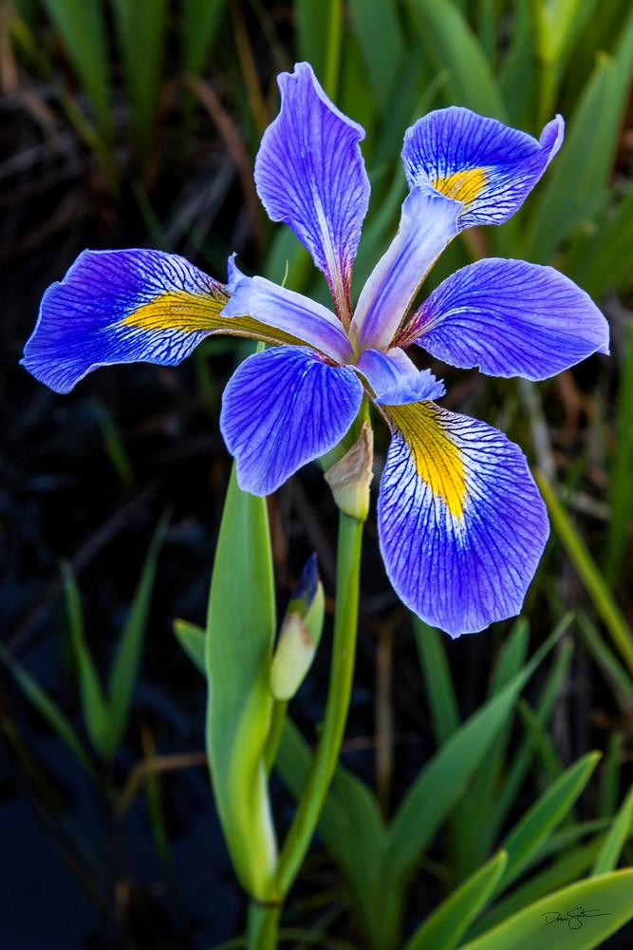
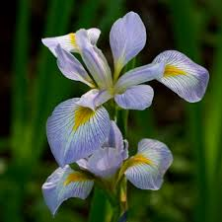
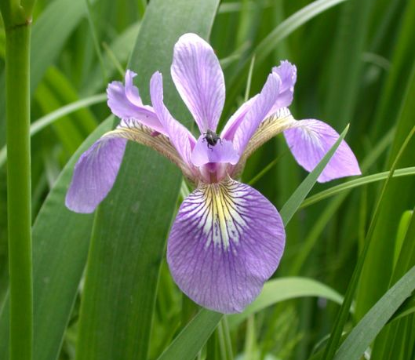
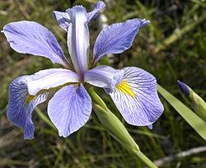
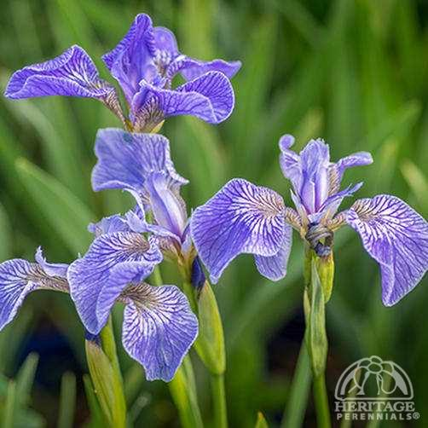
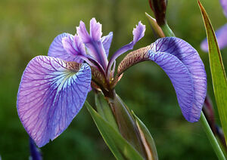
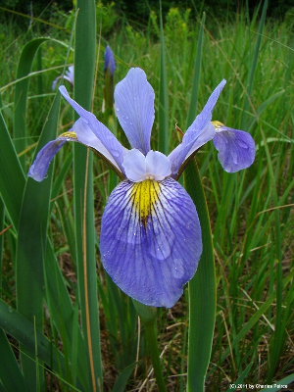
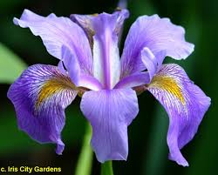
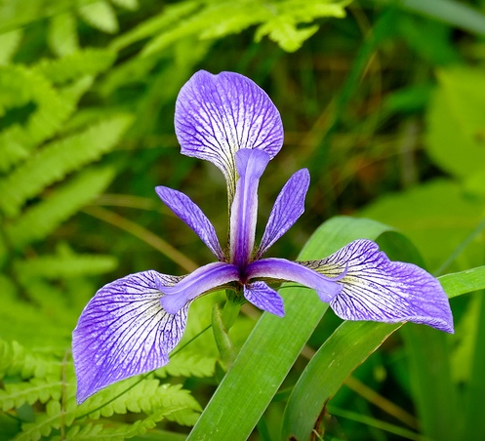
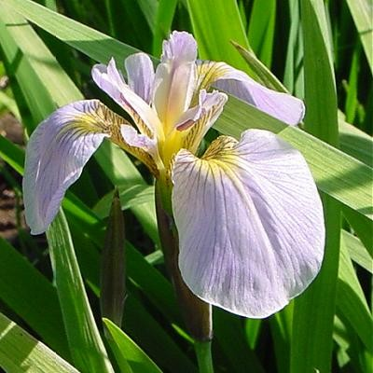
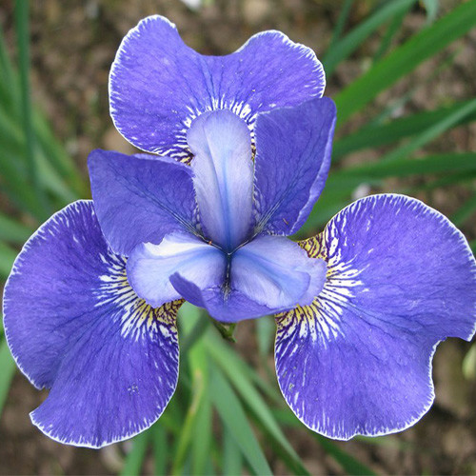
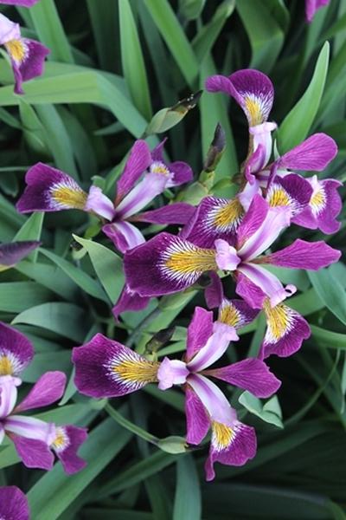
If I asked you to group the following 12 irises into 3 groups, could you do it?

Slide 3
Most likely, you could not classify the flowers correctly. Why?
The three species - iris virginica, iris setosa, and iris versicolor - are not distinguishable by the traits humans most commonly classified by: size, color, and shape
Even a skilled botanist would need to physically measure the flowers
So how could we classify flowers we have no access to?
A computer could do it for us

Slide 4
Machine Learning
First question: What are we looking for?
Test to determine which attributes are most valuable in determining flower species
Second question: Which model should we use?
There are a variety of models that may work: linear, logistic, support vector, and random forest are a few
Aka: a computer does it for you

Slide 5
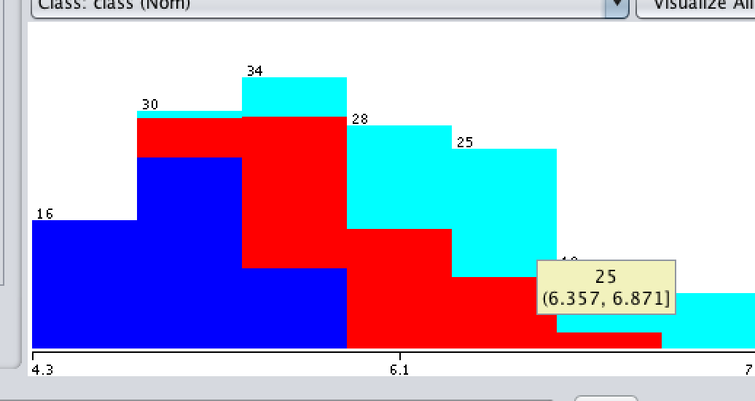
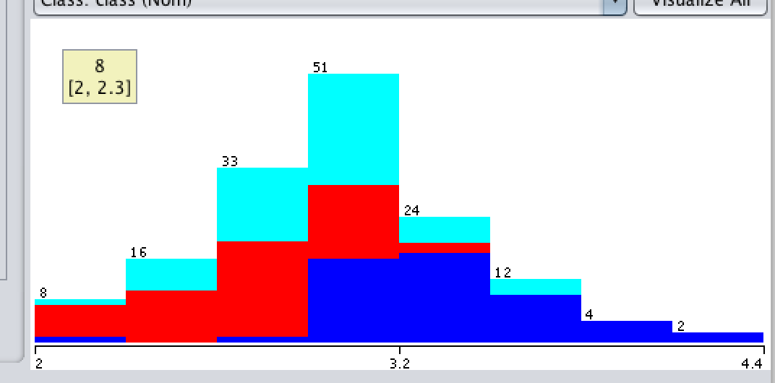
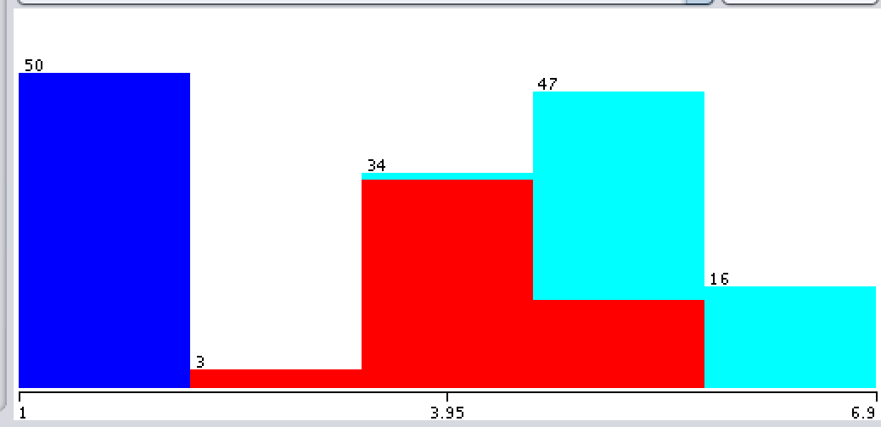
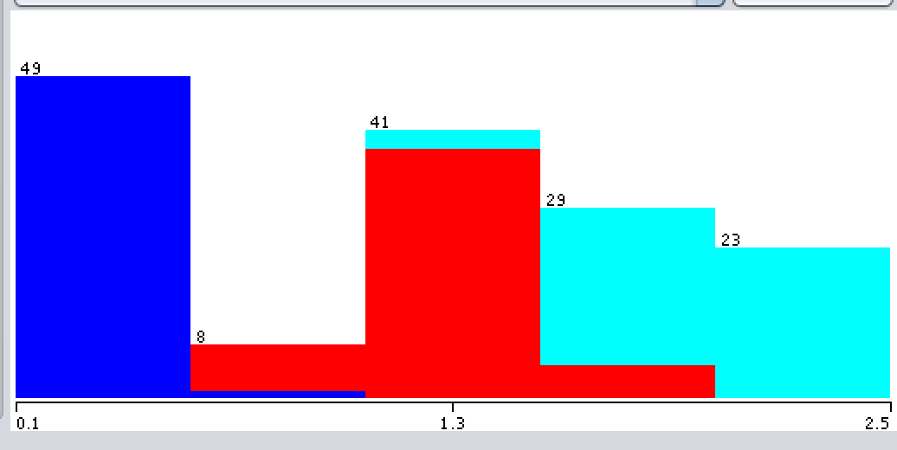
Let’s look at the 4 attributes across the 3 irises:
Sepal length
Sepal width
Petal width
Petal length

Slide 6
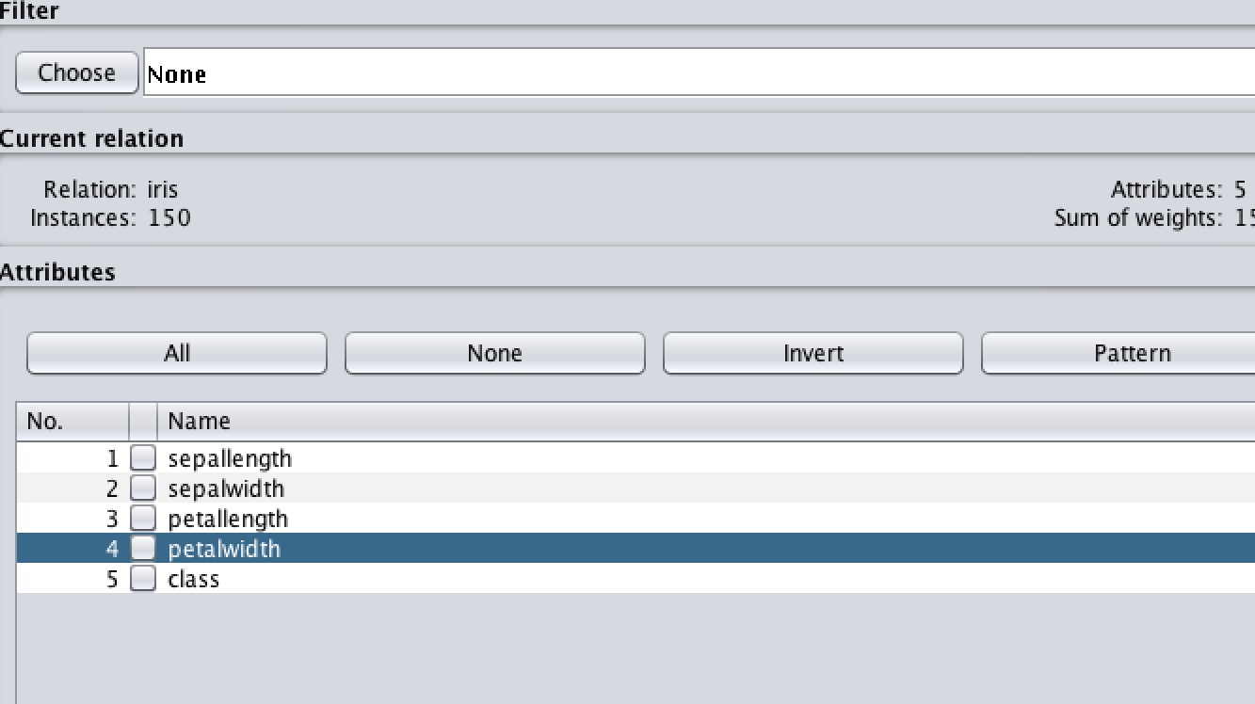
What do we know
Petal width was shown to be the most indicative of the right iris when taken by itself
We have to separate data into what we build the model from, and what we test by
Want the highest percentage of classification accuracy

Slide 7
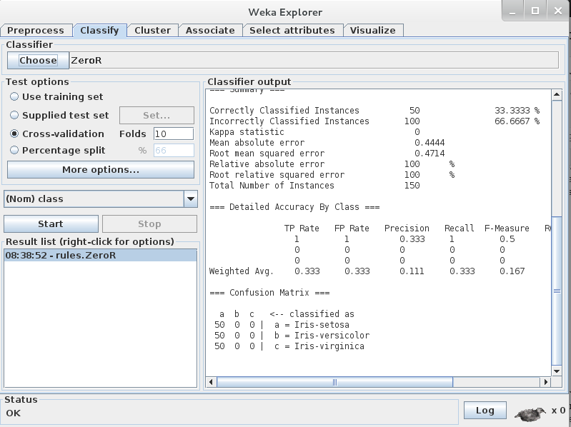
ZeroR model
Selects the majority class and uses that to base all its predictions
In this case, the iris data is 50-50-50 so it chooses the first one, setosa
The classification accuracy is 33.33%, which make sense because it will pick setosa a third of the time

Slide 8
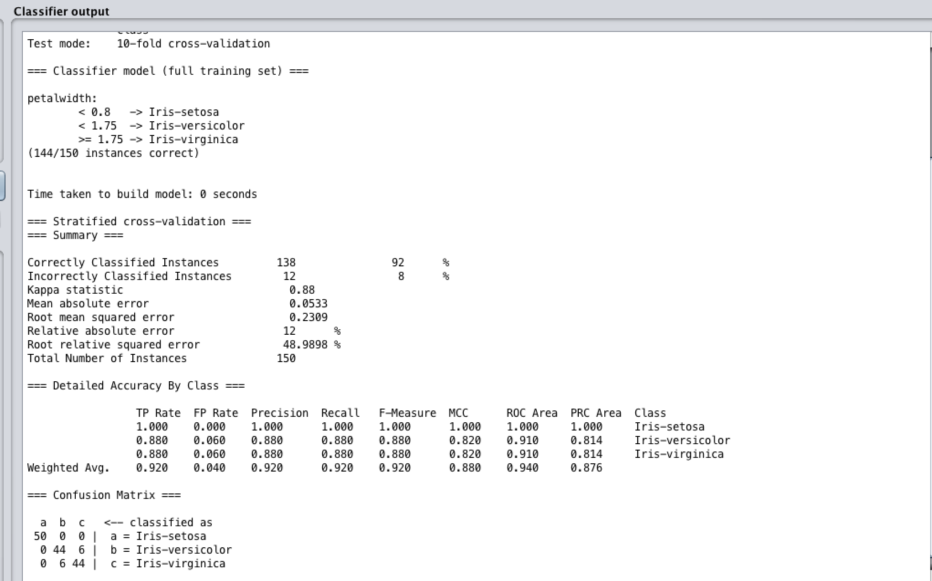
OneR model
Basic level of algorithms
One attribute does all the work: in this case, petal width
First separates irises based off of petal width, then takes the next attribute with the least overlap, and separates based off that again until no attributes are left

Slide 9
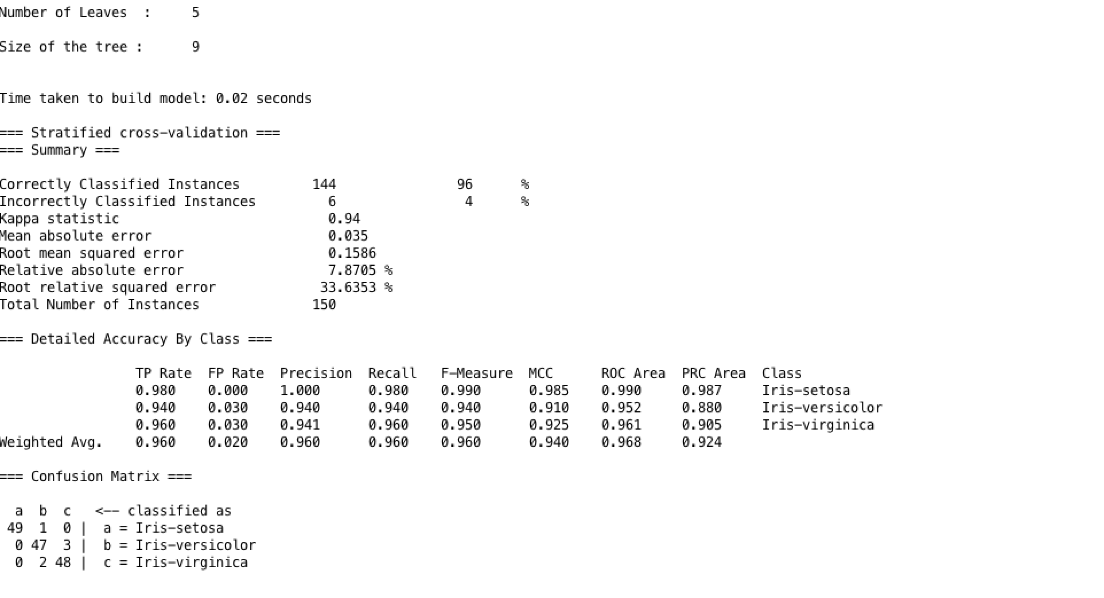
J48 model
Top down, recursive model,
Selects attribute first that splits the data into the most homogenous values
Then splits instances into subsets, one for each branch extending from the first attribute
Stop if all instances have the same class
Aim is to get the smallest tree and the “purest” ends: most homogenous classes
96% accuracy

